Slide 1

Team IT – B
(itpolsri)

Slide 2
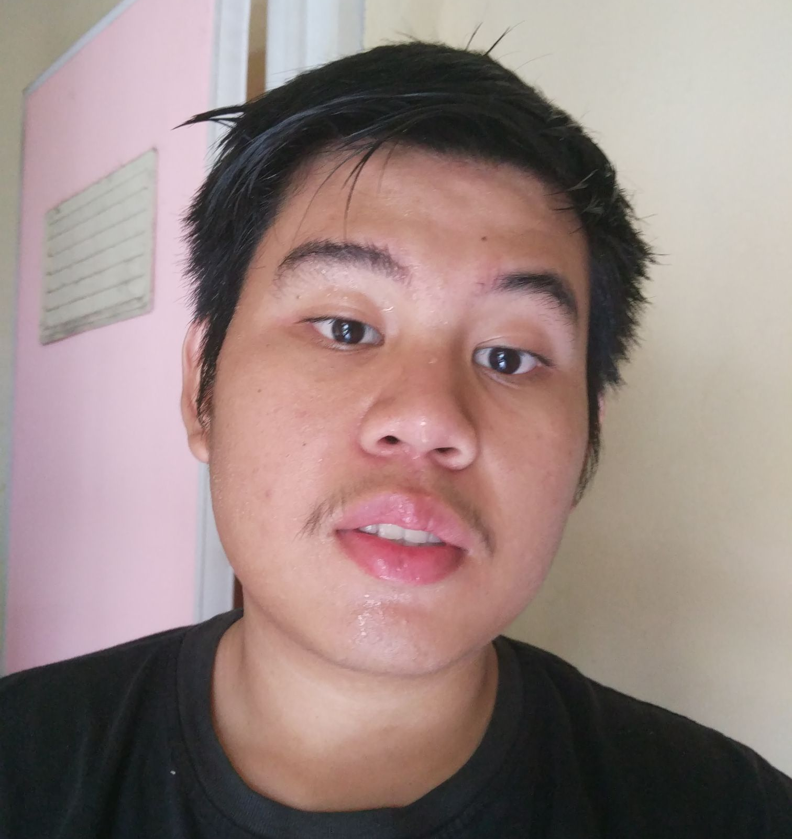
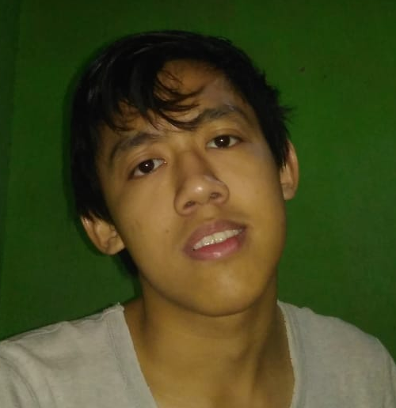
Muhammad Irvan Refnaldy
Sutan Gading Fadhillah Nst.
Front-End Web Developer
Back-End Web Developer

Slide 3
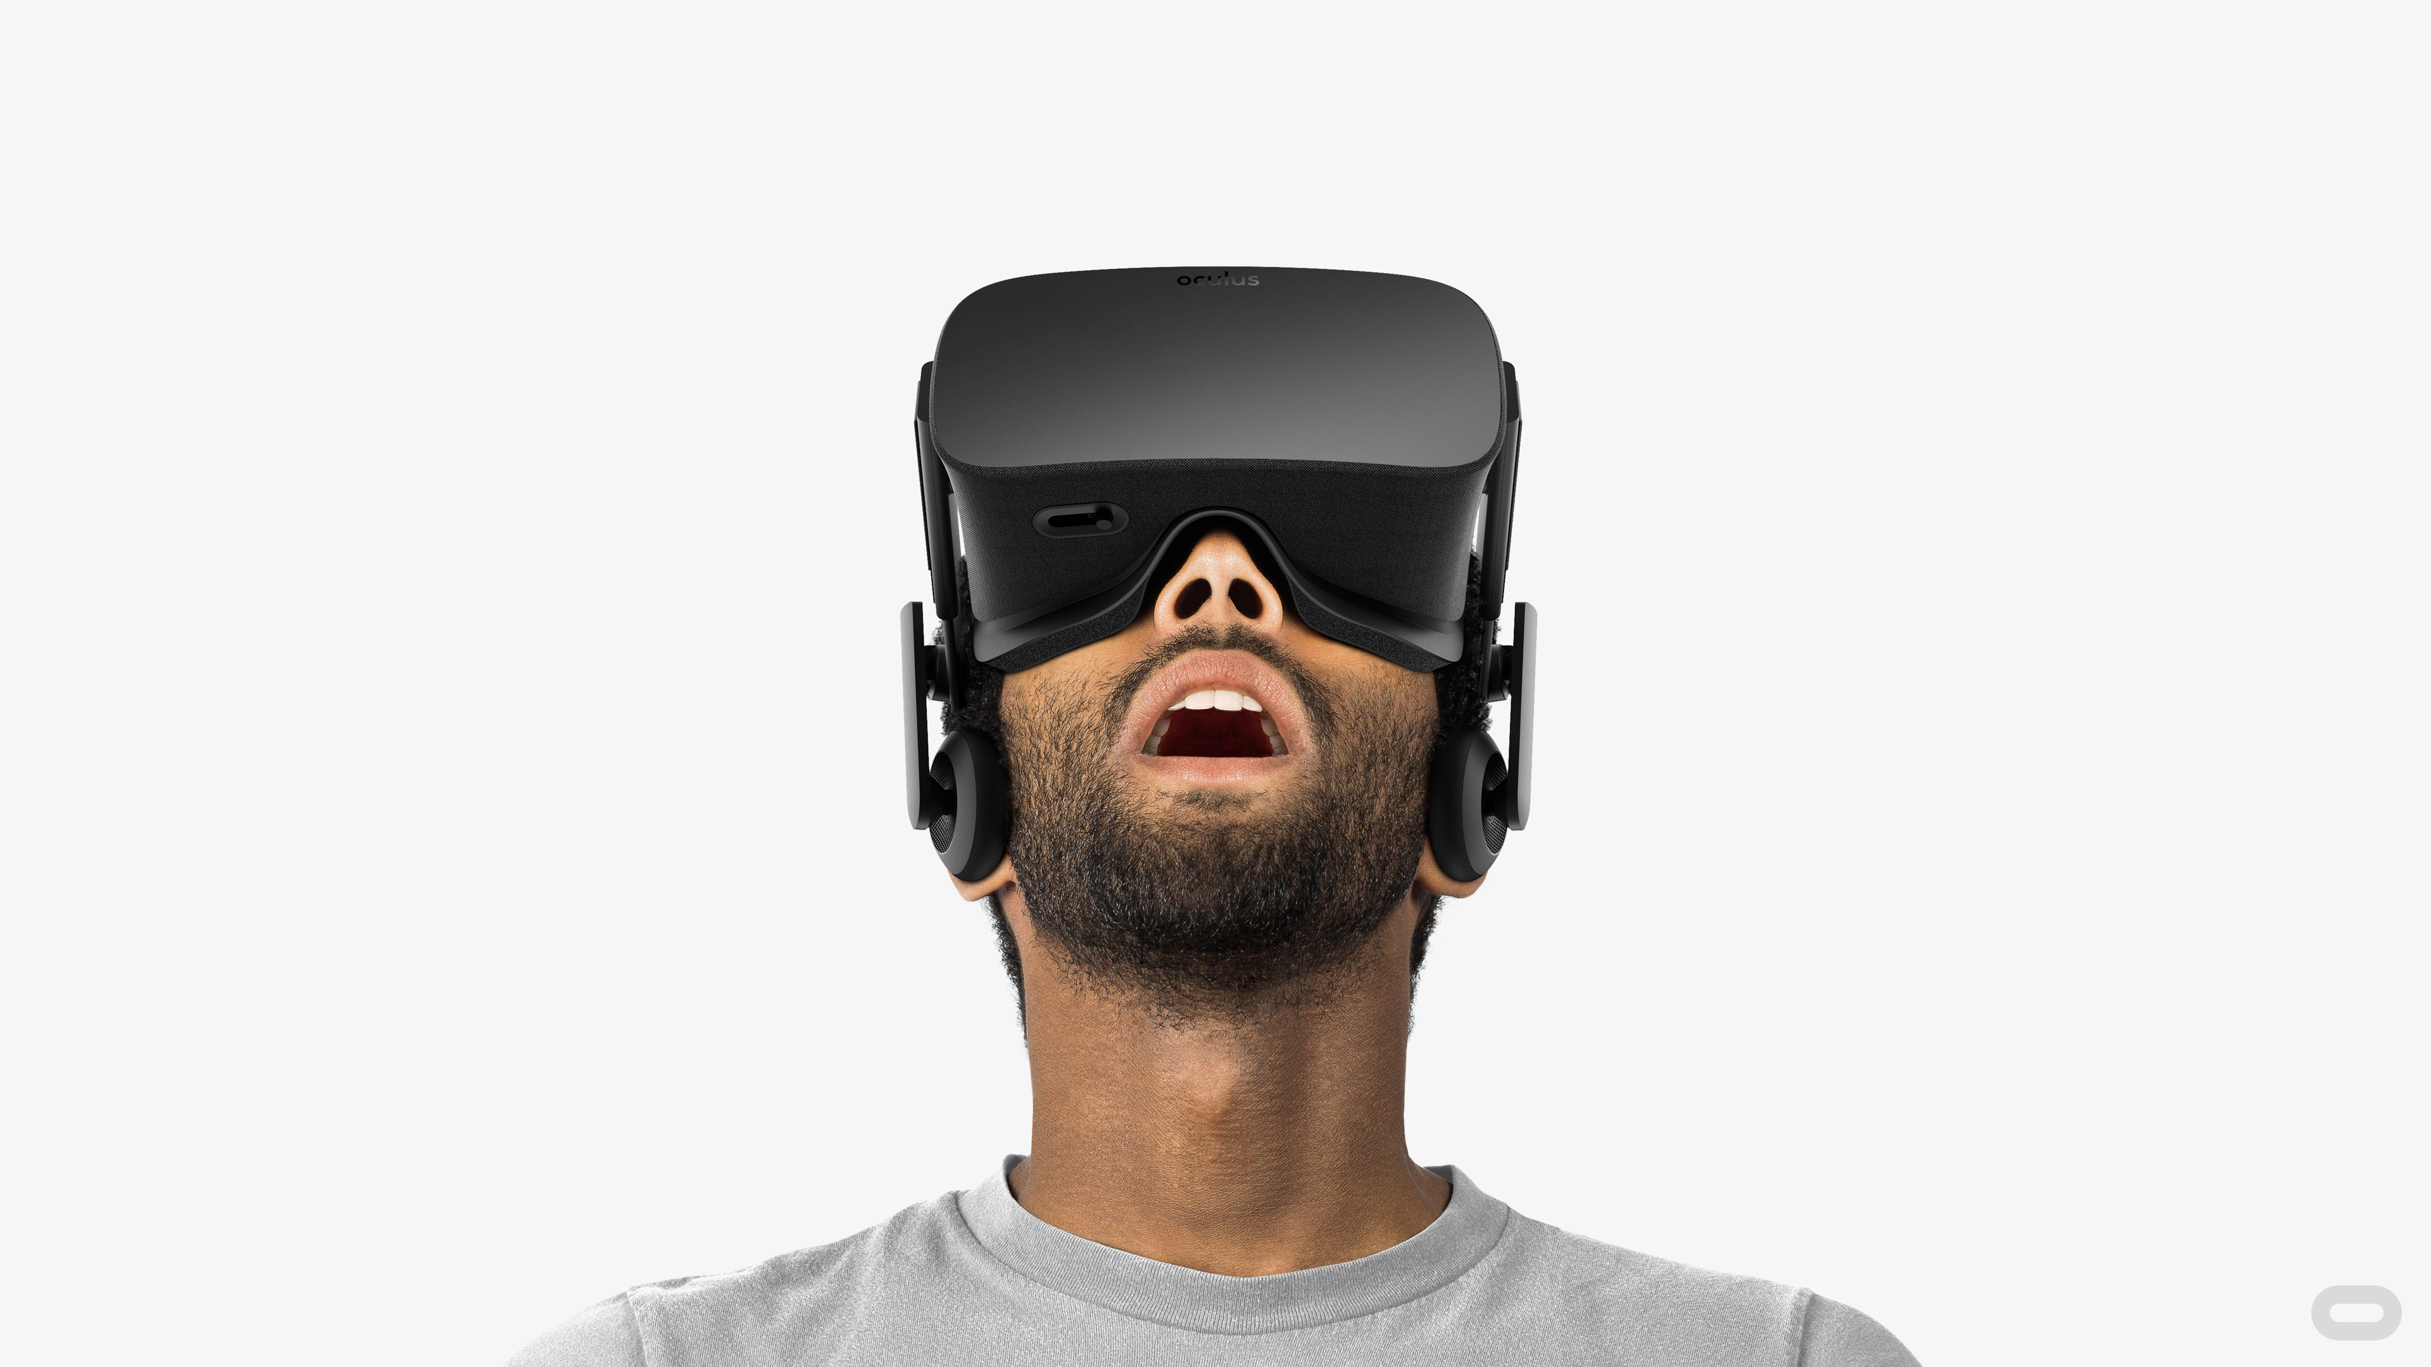
Virtual Reality ??

Slide 4

DEMO TIME

Slide 5








Technology

Slide 6


Slide 7
Q&A ?

